Slide 1
Software Project Management
Course Tutor: Desalegn Belay(Msc)
Target Group: 3rd Year SE Students

Slide 2
Evaluation
G.Assignt 20%
Mid 20%
Final 40%
Ind.Assignt 10%
Quizes 10%

Slide 3
Schedule
Wednesday
Morning:
4:00 – 6:00
Thursday
Afternoon 8:00-11:00

Slide 4
Attendance Requirements’
Minimum 85% during lecture session except for some unprecedented mishaps.

Slide 5
CHAPTER 1
1) Introduction to Software Project Management

Slide 6
1.1. Importance of IS project mgt.
Project management is important because it sets your project from being out of the scope.
10 benefits of project management listed below.
Consistent communication.
Effective resource allocation.
Higher productivity.
Improved customer satisfaction.
More flexibility.
Higher risk tolerance.
Improved morale.
Better planning.
Quality control.
Learning by retrospection.
Notes:
An effective allocation strategy identifies the project’s goals and priorities and collects resources to fit your needs throughout the project's lifecycle.
Resource allocation should be an early project consideration—ideally, aim to allocate resources during the project planning phase.
Learning by retrospection is the practice of looking back at past actions or decisions to learn from them and make better decisions in the future. It's a tool for continuous improvement that can be used in personal or professional development.
Productivity improvement, then, means getting more done – more output – with the same amount of input. Even better,
the best improvements can allow your business to increase p
Customer satisfaction is defined as a measurement that determines how happy customers are with a company's products, services, and capabilities. Customer satisfaction information, including surveys and ratings, can help a company determine how to best improve or changes its products and services.roductivity while decreasing cost.
Flexibility in project management is the freedom to plan and readjust their strategy as they go. It requires more detailed planning at the outset, but allows teams to react to roadblocks and ultimately achieve their targets with more consistency and less stress.
alleviates uncertainty=እርግጠኛ አለመሆንን ያስወግዳል
A constant flow of information, communicated consistently, alleviates uncertainty, and helps to develop mutual trust between the organization, its leaders and managers, and its employees
Principle of Consistency Communication often takes place through multiple tools/formats and over a period of time. It is important that communication is consistent with and does not conflict with the organization's policies, plans, programs and objectives.

Slide 7
Why need to manage SW projects?
Failure of many IT Projects. For instance,
The United States Internal Revenue System was to abandon its tax system modernization program after having spent $4 billion;
The state of California spent $1 billion on its non- functional welfare database system;

Slide 8
… why
The €339 million United Kingdom air traffic control system was reported as being two years behind schedule;
A 1995 Standish Group study (CHAOS) found that only 16.2% of IS projects were successful and over 31% were canceled before completion, costing over $81 B in the
U.S. alone
Worldwide cost of IT failure (revisited): $3 trillion
Notes:
The Chaos Report, or Comprehensive Human Appraisal for Originating Software, is a famous report about the IT industry.
The Standish Group International, Inc. or Standish Group is an independent international IT research advisory firm founded in 1985.
the Standish Group is a primary research advisory organization that focuses on software project performance.

Slide 9
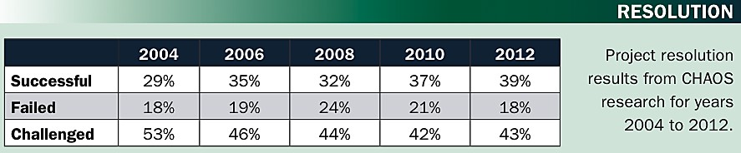
…why
The reasons for the increase in successful projects vary.
First,the average cost of a project has been more than cut in half.
Better tools have been created to monitor and control progress and
Better skilled project managers with better management processes are being used.
The fact that there are processes is significant in itself.”
Worldwide cost of IT failure (revisited): $3 trillion

Slide 10
Causes of Project Management Failure
Bad Communications
Poor schedule or resource Management (mismanagement)
Weak requirements definitions (leads to inadequate planning)
Inadequate planning, assumptions, risks, or resources
Use of new or unproven technologies/methods
Notes:
Bad communication can occur in many forms, including:
Ineffective listening: Not paying attention to what someone is saying
Lack of communication: Not saying anything, even when it's necessary
Lack of feedback: Not providing or asking for feedback, which can lead to uncertainty
Information overload: Giving someone too much information, making it hard to identify key points
Interrupting: A habit that can make people feel unheard and disrespected
Decreased morale: When morale is low, communication decreases, which can lead to more mistakes and re-work
Avoiding eye contact: Not maintaining eye contact can be a sign of poor communication skills
Avoiding difficult conversations: Avoiding important conversations can make problems worse in the long run
Poor communication often occurs when there's a discrepancy between what one person says and what another person hears. In other words, the person being communicated to misunderstands what you're trying to tell them, so there's no mutual understanding.

Slide 11
… Causes of PM Failure
Ineffective (or nonexistent) quality controls
Managing multiple projects at once or multi-tasking resources
Supply chain failures
Scope creep or poor impact analysis
Lack of qualified resources
Notes:
Scope creep: Adding additional features or functions of a new product, requirements, or work that is not authorized (i.e., beyond the agreed-upon scope).

Slide 12
Advantages of Using Formal SPM
Better control of financial, physical, and human resources
Improved customer relations
Shorter development times
Lower costs
Higher quality and increased reliability
Higher profit margins
Improved productivity
Better internal coordination
Higher worker morale

Slide 13
1.1.1,What is Project?
A project is a temporary endeavor undertaken to create a unique product or service.

Slide 14
Attributes of projects
Unique purpose
Temporariness
Require resources, often from various areas
Should have a primary sponsor and/or customer
Involve uncertainty
Notes:
Involve uncertainty=እርግጠኛ አለመሆንን ያካትታል

Slide 15
The Triple Constraint
Every project is constrained in different ways by its
Scope goals: What is the project trying to accomplish?
Time goals: How long should it take to complete?
Cost goals: What should it cost?
It is the project manager’s duty to balance these three often competing goals
Notes:
The triple constraint theory says that every project will include three constraints: budget/cost, time, and scope. And these constraints are tied to each other. Any change made to one of the triple constraints will have an effect on the other two.
Any limitation or restriction placed on a project is a constraint. For example, when you set a deadline for the project to be completed and released, you have given the project a time constraint.

Slide 16
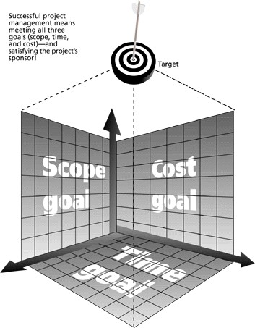
The Triple Constraint of Project Management

Slide 17
1.1.3 What is project management?
Project Management is the discipline of planning, organizing, and managing resources to bring about the successful completion of specific project goals and objectives.
Project management is “the application of knowledge, skills, tools, and techniques to project activities in order to meet project requirements.” (PMI*)
*The Project Management Institute (PMI) is an international professional society. Their web site is www.pmi.org.

Slide 18
Stages of project
Feasibility study
This is an investigation to decide whether a prospective project is worth starting.
information will be gathered about the general requirements of the proposed system.
the probable developmental and operational costs, along with the value of the benefits of the new system are estimated.
with a large system, the feasibility study could be treated as a project in its own right.
this evaluation may be done as part of a strategic planning exercise where a whole range of potential software development are evaluated and put into an order of priority.

Slide 19
The Cost-benefit Analysis
Cost-benefit analysis is designed to compare the costs and benefits of a project or programme.
It is often used when deciding whether to implement large projects, or choosing between different options.
It is normally applied before a project begins, but can also be used for monitoring and evaluation.

Slide 20
Planning
If the feasibility study produces results that indicate the prospective project appears viable, then planning of the project can take place .
in fact, for a large project, we would not do all our detailed planning right at the beginning.
We would formulate an outline plane for the whole project and a detailed one for the first stage.
More detailed planning of the later stages would be done as they approached.
This is because we would have more detailed and accurate information upon which to base our plans nearer to the start of the later stages.

Slide 21
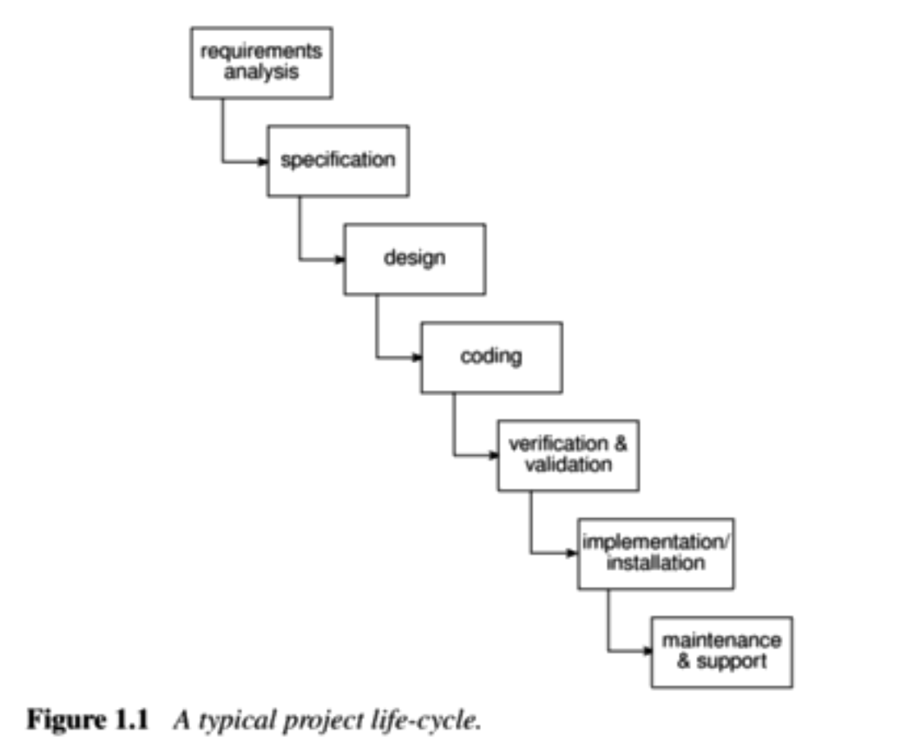
Project execution
The project can now be executed.
Individual projects are likely to differ considerably but a classic project life cycle is shown in figure 1.1

Slide 22
Project and Product Life Cycles
The Project Life Cycle
A project life cycle is a collection of generally sequential and
sometimes overlapping project phases
whose name and number are determined by the management and
control needs of the organization or organizations involved in the project, the nature of the project itself, and its area of application.
Notes:
There are typically five project life cycle phases: initiation, planning, execution, monitoring and controlling, and closure.
The Project Lifecycle consists of seven phases intake, initiation, planning, product selection, execution, monitoring & control, and closure. These phases make up the path that takes your project from start to finish.

Slide 23
Characteristics of the Project Life Cycle
Projects vary in size and complexity.
No matter how large or small, simple or complex,
all projects can be mapped to the following life cycle structure.
Starting the project,
Organizing and preparing,
Carrying out the project work, and
Closing the project.
This generic life cycle structure is often referred to when communicating with upper management or
other entities less familiar with the details of the project.
This high-level view can provide a common frame of reference for comparing projects—even if they are dissimilar in nature

Slide 24
Product life cycle
The product life cycle consists of generally sequential, non-overlapping product phases determined by the manufacturing and control need of the organization.
The last product life cycle phase for a product is generally the product’s retirement. Project life cycles occur in one or more phases of a product life cycle.
Care should be taken to distinguish the project life cycle from the product life cycle. All projects have a purpose or objective, but in those cases where the objective is a service or result, there may be a life cycle for the service or result, not a product life cycle
Notes:
Contact Us. A product life cycle is the length of time from a product first being introduced to consumers until it is removed from the market. A product's life cycle is usually broken down into four stages; introduction, growth, maturity, and decline.

Slide 25
The role of project manager
The project manager is the person assigned by the performing organization to achieve the project objectives.
The role of a project manager is distinct from a functional manager or operations manager.
Typically, the functional manager is focused on providing management oversight for an administrative area, and
operations managers are responsible for a facet of the core business.
Depending on the organizational structure,
a project manager may report to a functional manager.

Slide 26
Cont’d
In other cases, a project manager may be one of several project managers who report to a portfolio or
program manager that is ultimately responsible for enterprise-wide projects.
In this type of structure, the project manager works closely with the portfolio or
program manager to achieve the project objectives and
to ensure the project plan aligns with the overarching program plan.

Slide 27
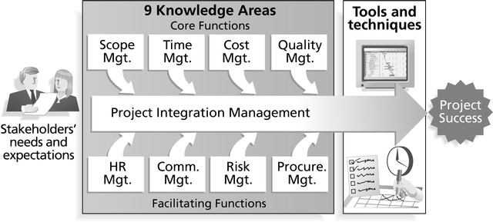
Project Management Framework

Slide 28
Project Stakeholders
Stakeholders are the people involved in or affected by project activities
Stakeholders include
the project sponsor and project team
support staff
customers
users
suppliers
opponents to the project

Slide 29
9 Project Management Knowledge Areas
Knowledge areas describe the key competencies that project managers must develop
4 core knowledge areas lead to specific project objectives (scope, time, cost, and quality)
4 facilitating knowledge areas are the means through which the project objectives are achieved (human resources, communication, risk, and procurement management
1 knowledge area (project integration management) affects and is affected by all of the other knowledge areas

Slide 30
Project Management Tools and Techniques
Project management tools and techniques assist project managers and their teams in various aspects of project management
Some specific ones include
Project Charter and WBS (scope)
Gantt charts, network diagrams, critical path analysis, critical chain
scheduling (time)
Cost estimates and earned value management (cost)

Slide 31
More Advantages of Project Management*
Bosses, customers, and other stakeholders do not like surprises
Good project management (PM) provides assurance and reduces risk
PM provides the tools and environment to plan,
monitor, track, and manage schedules, resources, costs, and quality
PM provides a history or metrics base for future planning as well as good documentation
Project members learn and grow by working in a cross-functional team environment
*Knutson, Joan, PM Network, December 1997, p. 13

Slide 32
How Project Management (PM) Relates to Other Disciplines
Much of the knowledge needed to manage
projects is unique to PM
However, project managers must also have knowledge and experience in
General management
The application area of the project
Project managers must focus on meeting specific project objectives

Slide 33


Project Management and Other Disciplines
Application area knowledge and practice
Project management knowledge and practice
General management knowledge and practice

Slide 34
What Helps Projects Succeed?
According to the Standish Group’s report CHAOS 2001: A Recipe for Success, the following items help IT projects succeed, in order of importance:
Executive support
User involvement
Experienced project manager
Clear business objectives
Minimized scope
Standard software infrastructure
Firm basic requirements
Formal methodology
Reliable estimates

Slide 35
Suggested Skills for a Project Manager
Communication skills: listening, persuading people
Organizational skills: planning, goal-setting, analyzing
Team Building skills: empathy, motivation, esprit de corps
Leadership skills: set example, energetic, vision (big
picture), delegates, positive
Coping skills: flexibility, creativity, patience, persistence
Technological skills: experience, project knowledge

Slide 36
Project Management Process Groups
Project management can be viewed as a number of interlinked processes
The project management process groups include
Initiating processes
Planning processes
Executing processes
Controlling processes
Closing processes

Slide 37
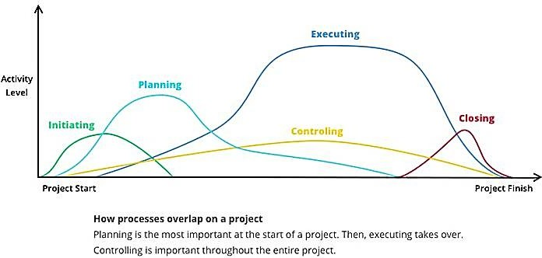
Overlapping of Process Groups in a Phase (PMBOK Guide, 2000, p. 31)

Slide 38
Relationships Among Process Groups, Activities, and Knowledge Areas
Knowledge Areas | Project Process Groups
 | Initiation | Planning | Executing | Controlling | Closing
Integration |  | Project plan development | Project plan execution | Integrated change control
Scope | Initiation | Scope planning |  | Scope verification
 |  | Scope definition |  | Scope change control
Time |  | Activity definition |  | Schedule control
 |  | Activity sequencing
 |  | Activity duration estimating
FACULTY OF | COMPUTING | BAHIR DA | Schedule development R INSTITUTE OF TECHNOLOGY | BA | HIR DAR UNIVERSITY | 34

Slide 39
Knowledge Areas | Project Process Groups
 | Initiation | Planning | Executing | Controlling | Closing
Cost |  | Resource planning |  | Cost control
 |  | Cost estimation
 |  | Cost budgeting
Quality |  | Quality planning | Quality assurance | Quality Control
Human resource |  | Organizational planning | Team development
 |  | Staff acquisition
Communication |  | Communications planning | Information distribution | Performance reporting | Administra tive closure
Risk |  | Risk management planning |  | Risk monitoring and control
 |  | Risk identification
 |  | Qualitative risk analysis
 |  | Quantitative risk analysis
 |  | Risk response planning
Procurement |  | Procurement planning | Solicitation |  | Contract close-out
FACULTY OF COM | PUTING | BAHIR DA | Solicitation planning R INSTITUTE OF TECHNOLOGY | BA | Source Selection HIR DAR UNIVERSITY |  | 35

Slide 40
I thank you.
36

